Slide 1
Sen-220 software engineering
System modeling-II

Slide 2
Class Diagram
Definition: A class diagram is a diagram showing a collection of classes and interfaces, along with the collaborations and relationships among classes and interfaces.
When you designed the use cases, you must have realized that the use cases talk about "what are the requirements" of a system?
The aim of designing classes is to convert this "what" to a "how" for each requirement.
Each use case is further analyzed and broken up into atomic components that form the basis for the classes that need to be designed

Slide 3
Class Diagram
A class diagram is a pictorial representation of the detailed system design.
A thing to remember is that a class diagram is a static view of a system. The structure of a system is represented using class diagrams. Class diagrams are referenced time and it used by the developers while implementing the system.
Class diagrams are used in nearly all Object Oriented software designs. Use them to describe the Classes of the system and their relationships to each other.
Note that these diagrams describe the relationships between classes, not those between specific objects instantiated from those classes

Slide 4
Class Diagram
A Few Terms
Responsibility of a class: It is the statement defining what the class is expected to provide.
Stereotypes: Classes that created at the early phases of the system design.
Boundary class: Users interact with the system through the boundary classes. (interface classes)

Slide 5
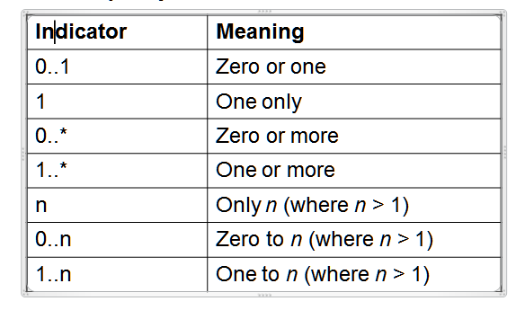
Class Diagram
Multiplicity Indicators.

Slide 6
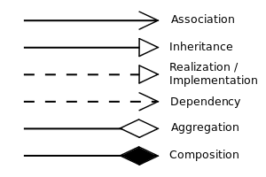

Slide 7
Association If two classes in a model need to communicate with each other, there must be a link between them, and that can be represented by an association (connector).
Aggregation implies a relationship where the child can exist independently of the parent. Example: Class (parent) and Student (child). Delete the Class and the Students still exist.
Composition implies a relationship where the child cannot exist independent of the parent. Example: House (parent) and Room (child). Rooms don't exist separate to a House.

Slide 8
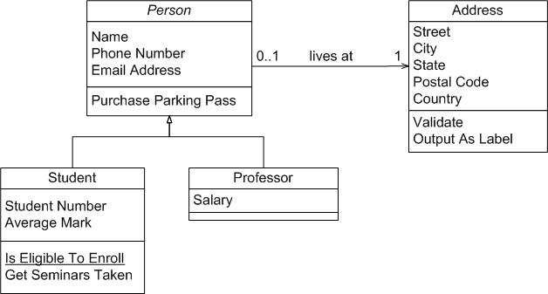
Class Diagram

Slide 9
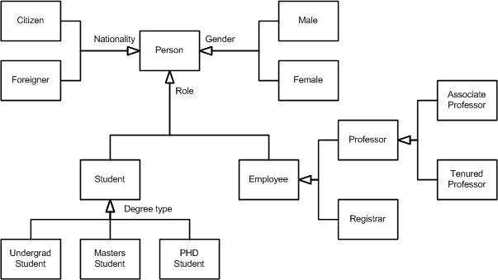
Class Diagram

Slide 10
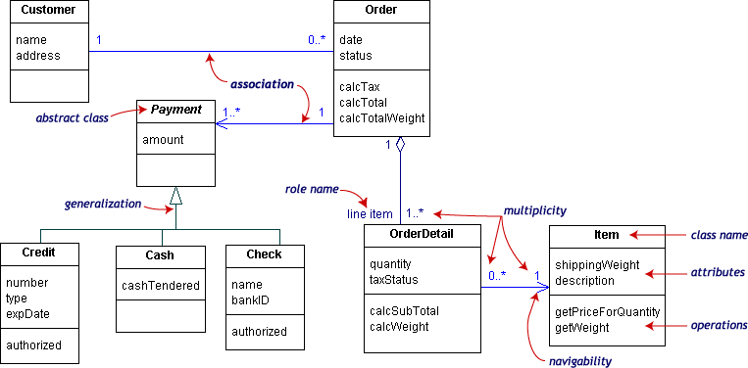
Class Diagram

Slide 11
A company consists of departments. Departments are located in one or more offices. One office acts as a headquarter. Eachdepartment has a manager who is recruited from the set of employees. Your task is to model the system for the company.
Task:
Draw a class diagram which consists of all the classes in your system their attributes and operations, relationships betweenthe classes, multiplicity specifications, and other model elements that you find appropriate

Slide 12
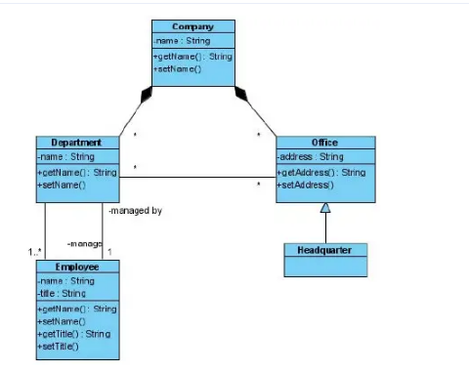

Slide 13
Activity diagram
Activity diagrams represent workflows in a graphical way. They can be used to describe the business workflow or the operational workflow of any component in a system. Sometimes activity diagrams are used as an alternative to State machine diagrams.

Slide 14
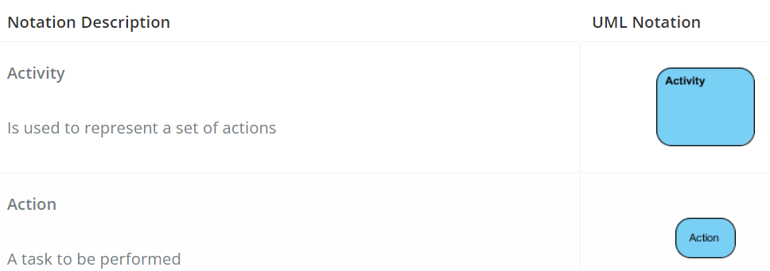
Activity Diagram Notation Summary

Slide 15
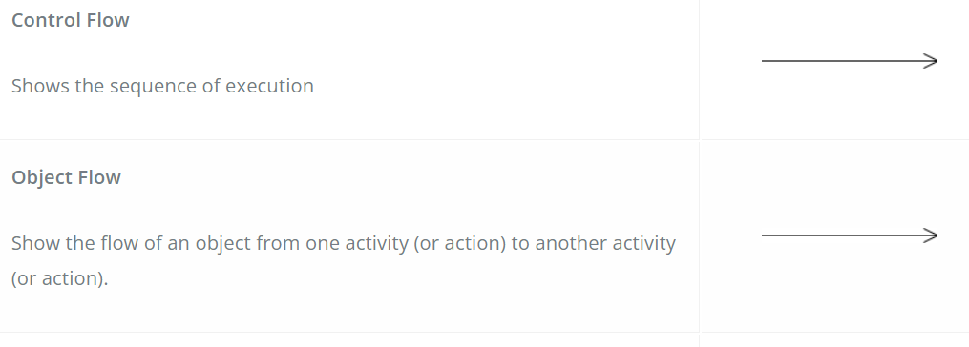
Activity Diagram Notation Summary

Slide 16
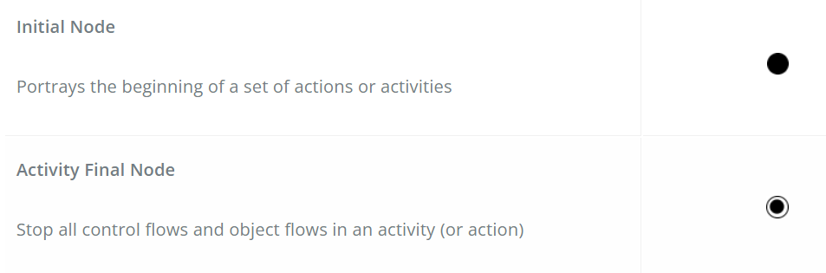
Activity Diagram Notation Summary

Slide 17
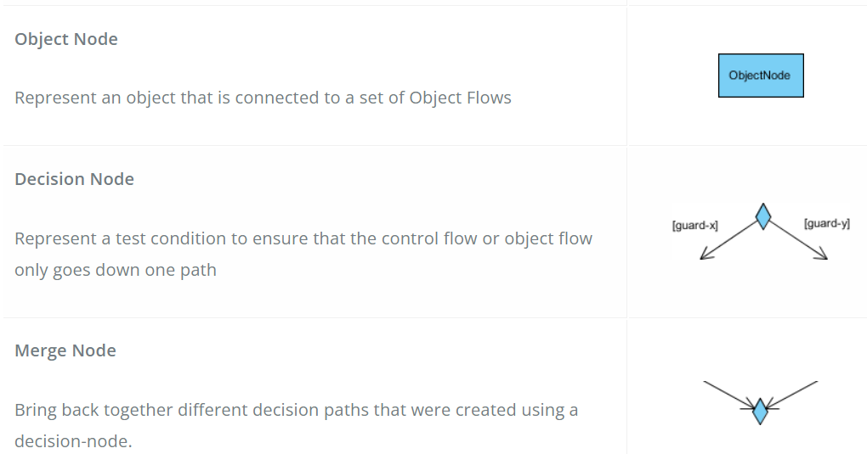
Activity Diagram Notation Summary

Slide 18
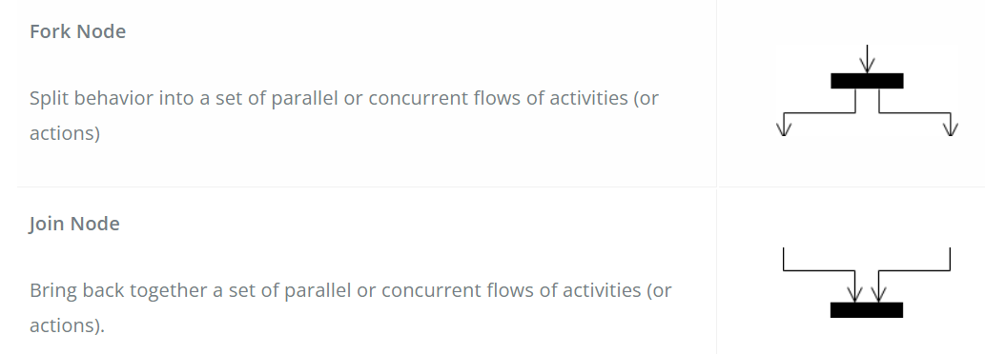
Activity Diagram Notation Summary

Slide 19
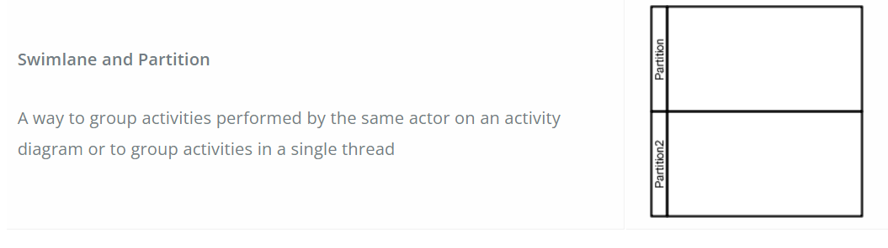
Activity Diagram Notation Summary

Slide 20
Activity Diagram - Modeling a Word Processor
The activity diagram example below describes the workflow for a word process to create a document through the following steps:
Open the word processing package.
Create a file.
Save the file under a unique name within its directory.
Type the document.
If graphics are necessary, open the graphics package, create the graphics, and paste the graphics into the document.
If a spreadsheet is necessary, open the spreadsheet package, create the spreadsheet, and paste the spreadsheet into the document.
Save the file.
Print a hard copy of the document.
Exit the word processing package.

Slide 21
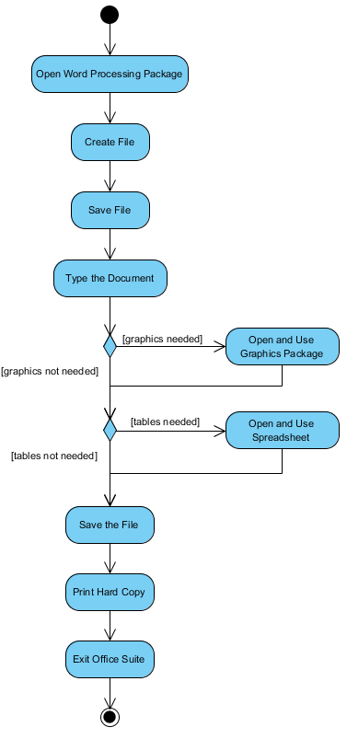
Activity Diagram - Modeling a Word Processor

Slide 22
Activity Diagram – Process order
Process Order - Problem Description
Once the order is received, the activities split into two parallel sets of activities. One side fills and sends the order while the other handles the billing.
On the Fill Order side, the method of delivery is decided conditionally. Depending on the condition either the Overnight Delivery activity or the Regular Delivery activity is performed.
Finally, the parallel activities combine to close the order.

Slide 23
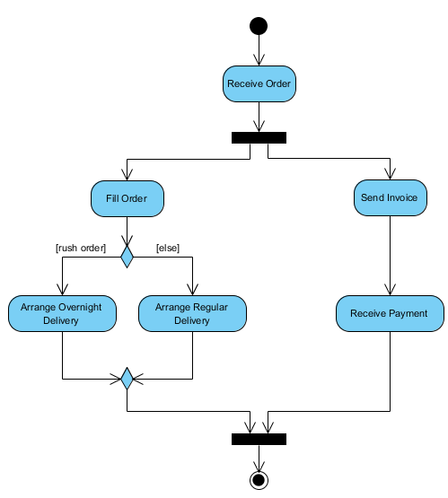
Activity Diagram – Process order

Slide 24
Activity Diagram – student enrollment
Example describes a process for student enrollment in a university as follows:
An applicant wants to enroll in the university.
The applicant hands a filled out copy of Enrollment Form.
The registrar inspects the forms.
The registrar determines that the forms have been filled out properly.
The registrar informs student to attend in university overview presentation.
The registrar helps the student to enroll in seminars
The registrar asks the student to pay for the initial tuition.

Slide 25
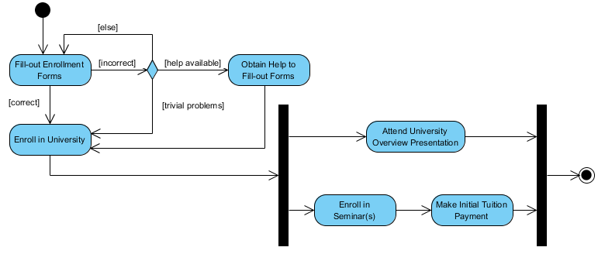
Activity Diagram – student enrollment

Slide 26
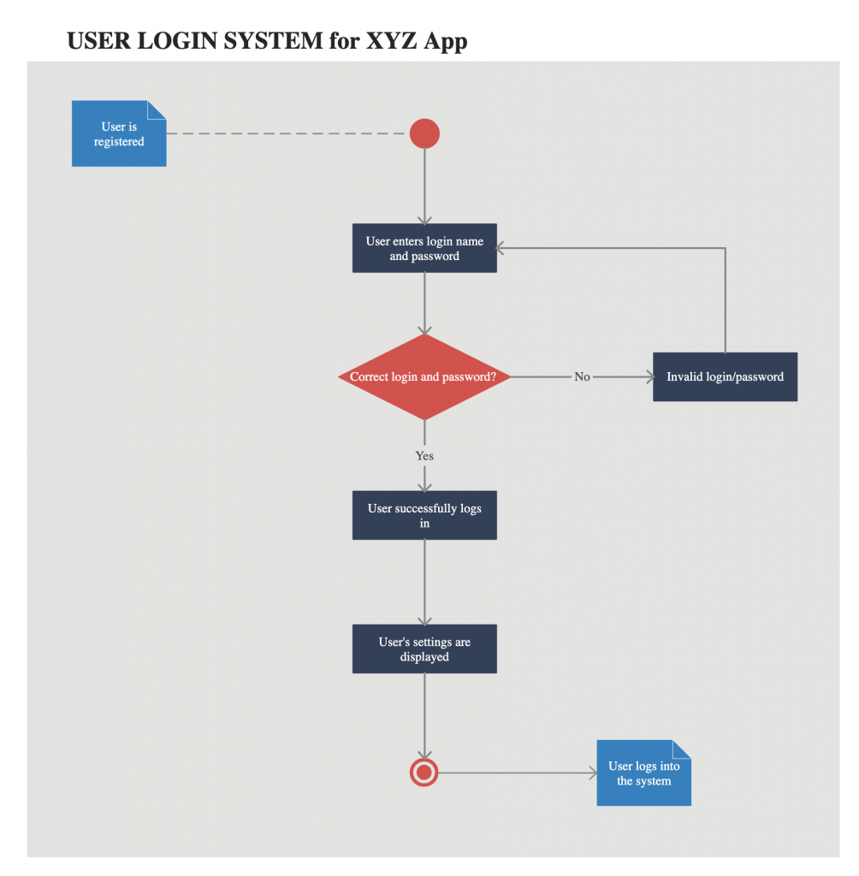
Activity Diagram – user login system for XYZ Application

Slide 27
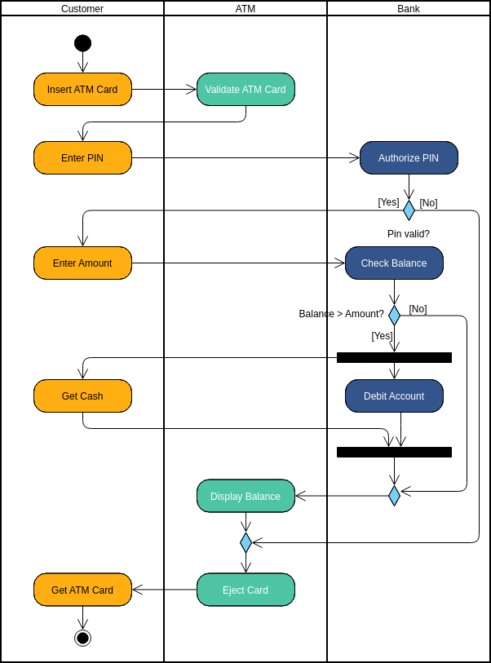
Activity Diagram – Swimlane [ATM Bank Example]

